Slide 1

VR based Convenience Store using ML
Group No. 20
Jaaie Kadam 18104017
Prachi Manera 17104013
Project Guide
Prof. Anagha Aher

Slide 2
Contents
Introduction
Objectives
Problem Definition
Technological Stack
Review Suggestions (Given in Last meeting)
Proposed System Architecture/Working
Prototype Design Demonstration
Implementation Status
Status of Paper Draft & Targeted Conference

Slide 3
Introduction
3D Convenience store is a mobile app powered by Virtual Reality to enable advanced shopping experience.
3D Convenience store focuses on bringing a more practical approach to the current shopping system(2D & on-site) using 3D simulation and interaction.
The proposed system introduces a VR based 3D Convenience store where the user can experience Real world based shopping activities Virtually from the Comforts of their home.
This virtual Convenience store will have an easy to interact UI.

Slide 4
Objectives
To advance the current Shopping system by providing user an immersive experience.
To allow the users get the feel of the object’s texture, pattern similar to that of real world shopping.
To cut down the amount of time required to search the products by suggesting relevant items to the user.

Slide 5
Problem Definition
With the 2D shopping websites used today, they have their natural limitations, which is a particularly important element of shopping.
Malls and grocery shops are closed or there are many restrictions imposed on them due to ongoing pandemic.
Customers have to wait in long queues in order to get the tokens increasing the manual work and the amount of time.

Slide 6
Technological Stack
Software Requirements:
• 3D Modelling – 3Ds Max
• VR Engine - Unity (C#)
Machine learning algorithms
Hardware requirements:
• VR Headsets with Bluetooth controller – Rs. 3000/- approx.

Slide 7
Review Suggestions
Decide if it is going to be a desktop app or a mobile app
(Using Android store, mobile app will be developed)
Finalize the Products range
(This app will be focusing on all the things available in Grocery Store)

Slide 8
Proposed System Architecture/Working
Input Hardware
(Headset)
USER
Output Hardware
Processing Software
VR Store Simulator
Rendering Engine
Web Admin Panel
Database Web Server
Product Information

Slide 9
Prototype Design Demonstration
Gaze Origin
(Center of cornea)
Right lens origin
(0,0,0)
Right angle gaze
System origin
Combined
gaze
Target
Left angle gaze
Left lens origin
(0,0,0)

Slide 10
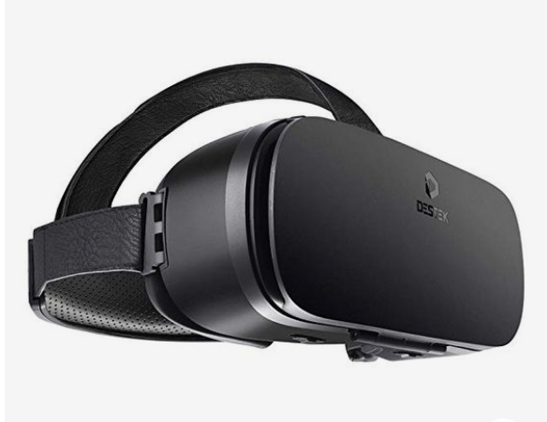
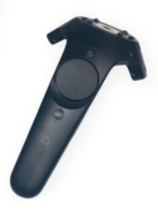
Prototype Design Demonstration
Objects
Virtual Tracer
Virtual Stick
3D angle in VR

Slide 11
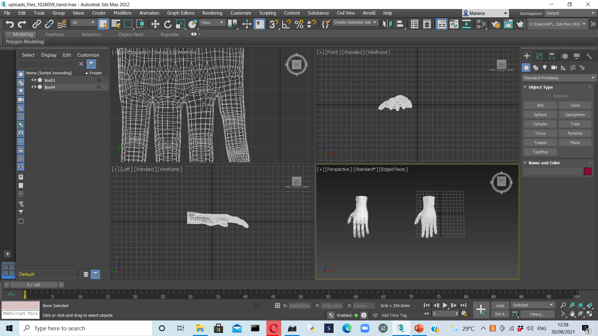
Implementation Status
Learning Autodesk 3Ds Max.
Hand Modelling

Slide 12
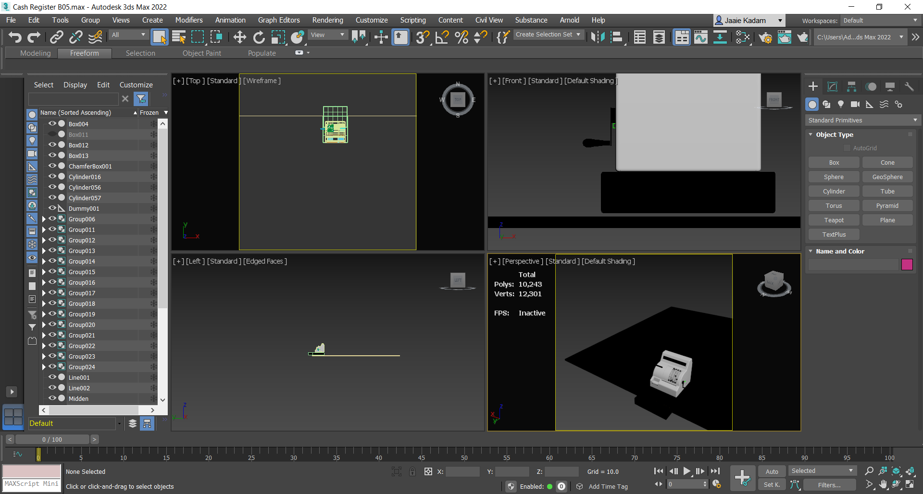
Implementation Status
Cash Register
Cash Register

Slide 13
Status of Paper Draft & Targeted Conference
Abstract of Paper done
Targeted Conferences:
IEEE International Conference on Computational Intelligence and Computing Applications-21
https://easychair.org/cfp/IEEEICCICA21

Slide 14
Thank You...!!

